Slide 1
Multiple Linear Regression (MLR)
Multicollinearity, Categorical Variables, Adjusted R², Hands-on Example

Slide 2
Introduction
MLR models relationship between one dependent variable and multiple independent variables.
Equation: Y = β₀ + β₁X₁ + β₂X₂ + ... + β_{n}X_{n} + ε
Goal: Predict outcomes and understand influence of predictors.

Slide 3
Key Concepts
Dependent Variable (Y): outcome to predict.
Independent Variables (X): predictors or features.
Coefficients (β): measure predictor impact.
Error Term (ε): unexplained variability.

Slide 4
Assumptions of MLR
Linearity between predictors and outcome.
Independence of errors.
Homoscedasticity (constant variance of residuals).
No multicollinearity among predictors.
Normality of residuals.

Slide 5
What is Multicollinearity?
In Multiple Linear Regression (MLR), we assume each predictor (independent variable) gives us unique information about the dependent variable.
But if two predictors are highly correlated (e.g., "Size of house in sq ft" and "Number of rooms"), they overlap in the information they provide.

Slide 6
Why is it a problem?
Makes it hard to interpret coefficients (because the model cannot decide which variable actually explains the change in Y).
Leads to unstable estimates (coefficients may flip signs when you add/remove variables).
Reduces the statistical significance of predictors.

Slide 7
How to detect multicollinearity
Correlation matrix: Calculating a correlation matrix for all independent variables is a basic first step. While this can detect simple pairwise correlations, it may not find more complex relationships.
Variance Inflation Factor (VIF): A more robust method is to calculate the VIF for each independent variable.

Slide 8
How to mitigate multicollinearity?
Remove a variable: If two variables are highly correlated, you can remove one of them from the model.
Combine variables: You can create a composite variable or an index from the correlated variables.
Use regularization methods: Techniques like Ridge or Lasso regression are designed to handle multicollinearity.

Slide 9
Handling Categorical Variables
Multiple linear regression can incorporate categorical variables by converting them into numerical data using dummy variables.
Categorical variables must be transformed.
Dummy Variables: convert categories to binary (0/1).
One-hot Encoding: represent each category as a variable.
Example: Gender → Male (0), Female (1).

Slide 10
One Hot Encoding
One Hot Encoding is a method for converting categorical variables into a binary format. It creates new columns for each category where 1 means the category is present and 0 means it is not. The primary purpose of One Hot Encoding is to ensure that categorical data can be effectively used in machine learning models.

Slide 11
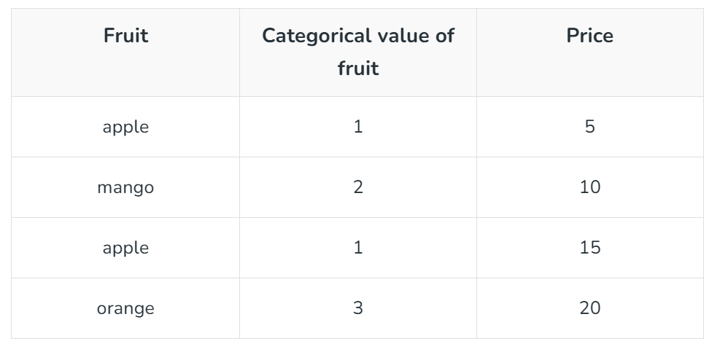
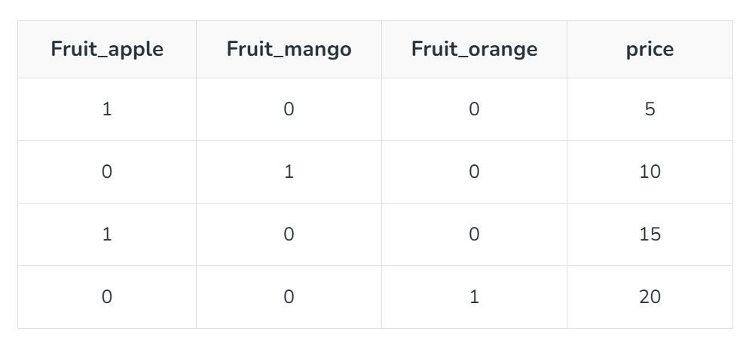
One Hot Encoding

Slide 12
Label Encoding
Label Encoding assigns a unique number to each category but implies an artificial order, while One-Hot Encoding creates a new binary (0/1) column for each category, avoiding ordinality and increasing data dimensionality.
In a dataset with a Fruit column containing "Apple," "Banana," and "Orange," label encoding can map : Apple -> 0 Banana -> 1 Orange -> 2

Slide 13
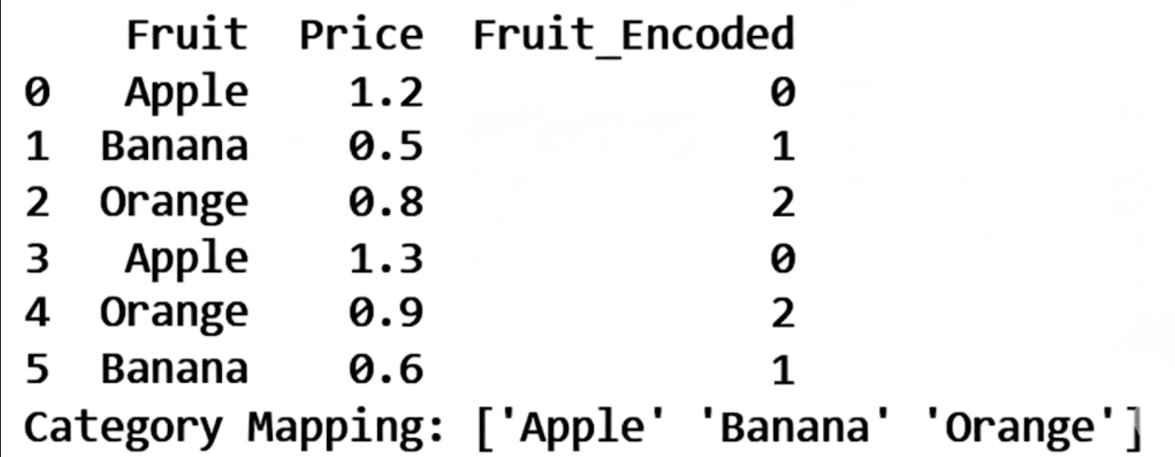
Result After Label Encoding

Slide 14
Adjusted R²
The coefficient of determination, (R²), measures the proportion of variance in the dependent variable explained by the independent variables.
A key limitation of (R²) is that it never decreases as more variables are added to the model, which can lead to overfitting.
Problem: R² always increases with more variables.
Adjusted R² penalizes irrelevant predictors.
Formula: Adjusted R² = 1 - ((1-R²)(n-1))/(n-k-1).

Slide 15
Why use adjusted R²?
Corrects for overfitting: Adjusted R² addresses the issue by penalizing the model for each additional independent variable that does not improve the model's explanatory power.
Helps with variable selection: It provides a better measure of a model's goodness-of-fit, especially when comparing models with different numbers of predictors.
Can decrease: Unlike R² , the adjusted R² can decrease if a new variable does not significantly improve the model, providing a more reliable metric.

Slide 16
Multivariate Set
Data with more than one independent variable (feature) affecting the dependent variable (target).
Univariate dataset → only one variable (e.g., just student scores).
Bivariate dataset → two variables (e.g., hours studied vs exam score).
Multivariate dataset → more than two variables, where several features together explain or predict the outcome.

Slide 17
Interpretation of Results
Coefficients show predictor effect.
Significance tests (p-values) identify important predictors.
Adjusted R² indicates overall model fit.

Slide 18
Conclusion
MLR helps understand complex relationships.
Check multicollinearity and categorical handling.
Adjusted R² provides fair evaluation.
Widely applied across domains.

